Slide 1

CHS
College
Process

Slide 2
School Counselor
Caseload Breakdown
Mrs. McDowell: A-B (rmcdowell@aacps.org)
Ms. Maziarz: C-G (amaziarz@aacps.org)
Mrs. Schenk: H-McG (cschenk@aacps.org)
Mrs. Thress: McH-Se (kthress@aacps.org)
Mrs. Gibbons: Sh-Z (kmgibbons@aacps.org)

Slide 3
Class Advisors and Administrator
Class Advisors
Ms. Jenkins (mkjenkins@aacps.org)
Class Administrator
Ms. Jones (jmjones@aacps.org)

Slide 4
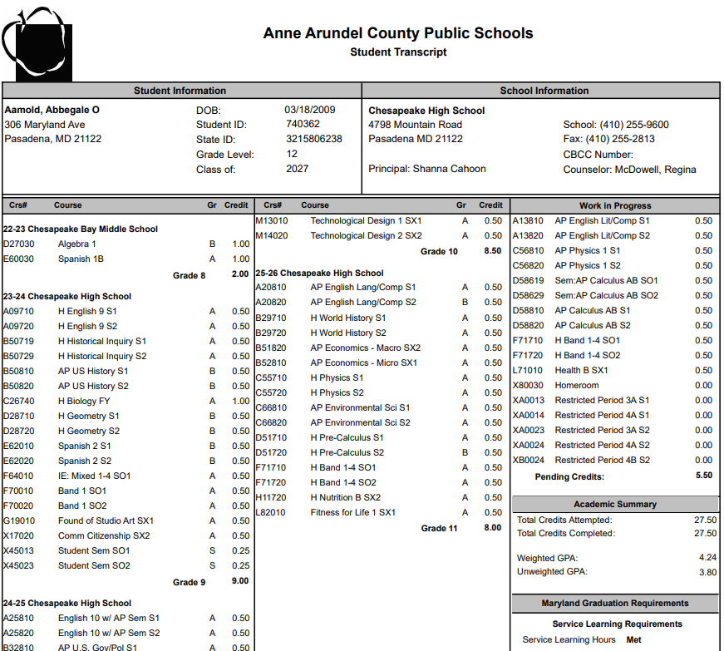
How Your Transcript Can Help
CHS Information
Current Classes
Total Credits
GPA

Slide 5
Anne Arundel Community College
Accuplacer
Degree and Certificate Programs
Personal Registration Day
Elena White: epwhite@aacc.edu

Slide 6
FAFSA
All students planning to continue their education at a post-secondary institution, should complete FAFSA
Create FSA ID
  You can create this NOW, please do so! ☺
Opens in October, closes March 1st for MD. However, some colleges have earlier deadlines.
We have a virtual FAFSA Information session through AACC on 10/26.

Slide 7
MHEC
If you’re planning on attending a Maryland school, it is also important to create an account with Maryland Higher Education Commission (MHEC)
https://mhec.maryland.gov/preparing/Pages/FinancialAid/descriptions.aspx

Slide 8

The Common Application
www.commonapp.org
Pieces of the Common Application may need to be completed first before you will be able to access college requests in Naviance

Slide 9
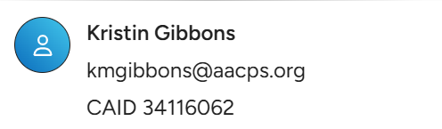
Step One
Log onto www.commonapp.org in order to create an account.
  Be sure to write down your ID and password to avoid being locked out of your account
Take note of your Common App ID Number

Slide 10

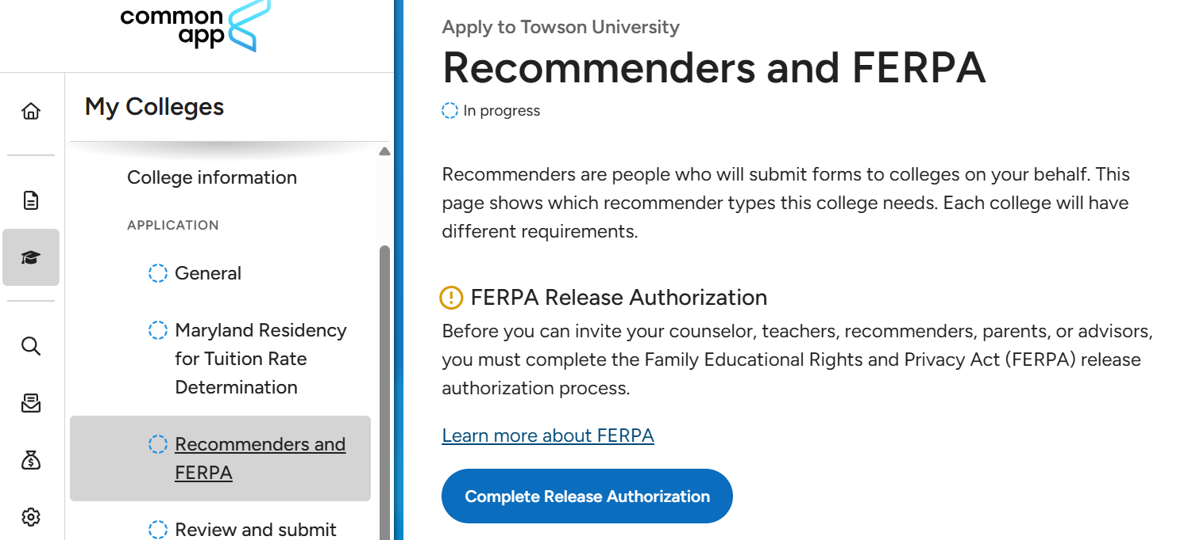
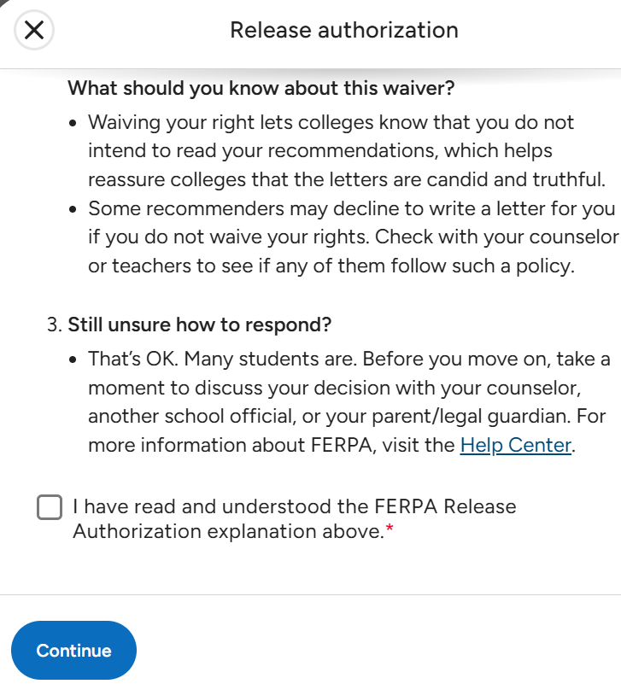
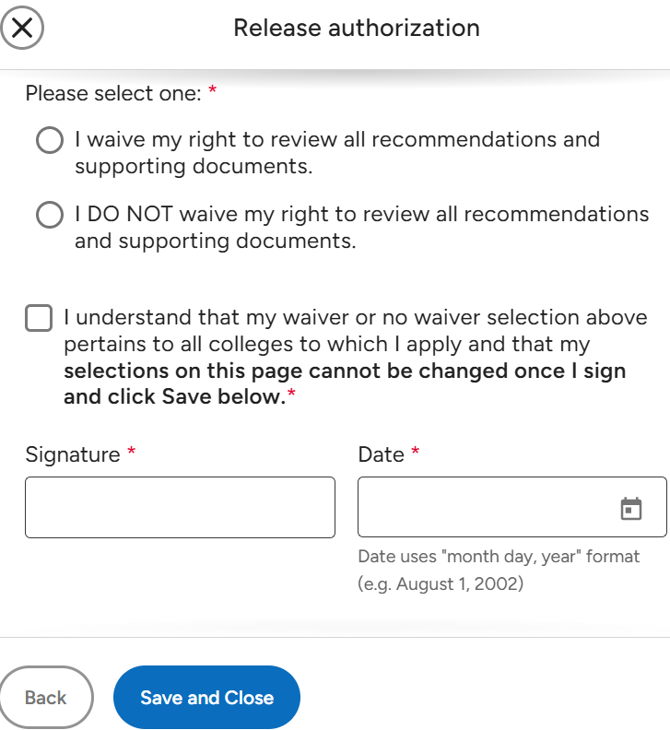
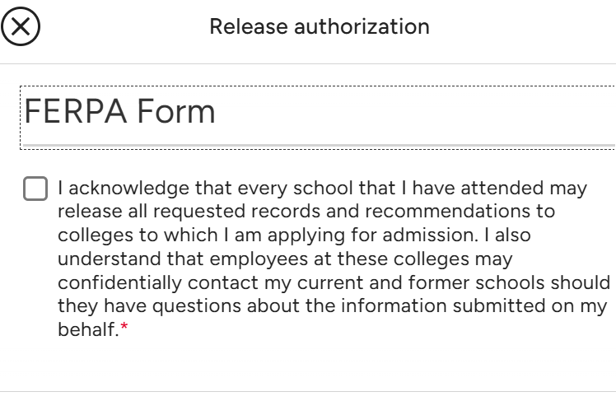
FERPA
Click on button to confirm your consent for CHS to release your educational information to colleges (FERPA)
Read through the form and check the appropriate boxes

Slide 11
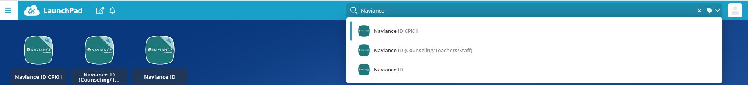
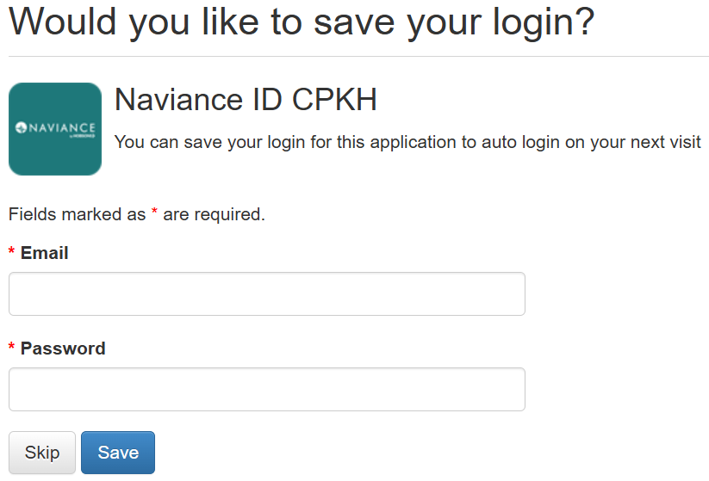
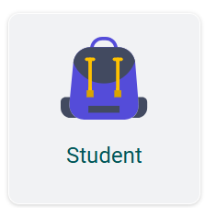
Naviance
Can be accessed through the AACPS ClassLink page
Logging in to Naviance
    If prompted with this screen, please click on skip
    On the Welcome to Naviance screen, please click on Student icon

Slide 12
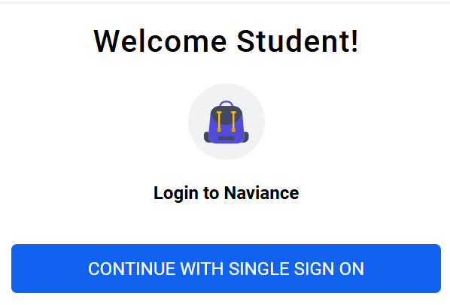
Naviance
Logging in to Naviance continued
    Click on the Single Sign-On button
Mobile-friendly so can be accessed on any device

Slide 13
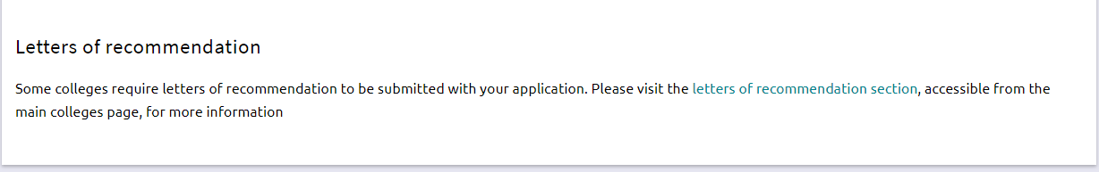

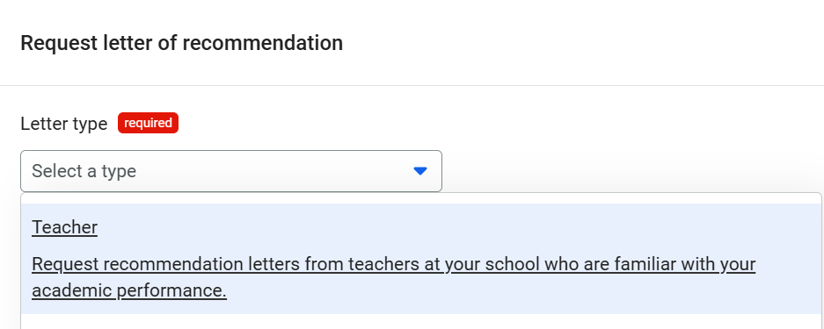
Teacher Letters of Recommendation
Select the people that you would like to write your letters of recommendation; an email will be sent to each selected person
You may include an optional note to a particular recommender
  Click on this button
  Then select Teacher

Slide 14
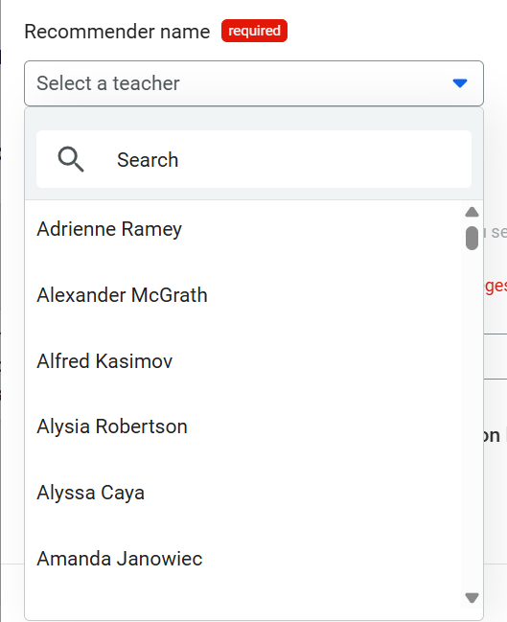
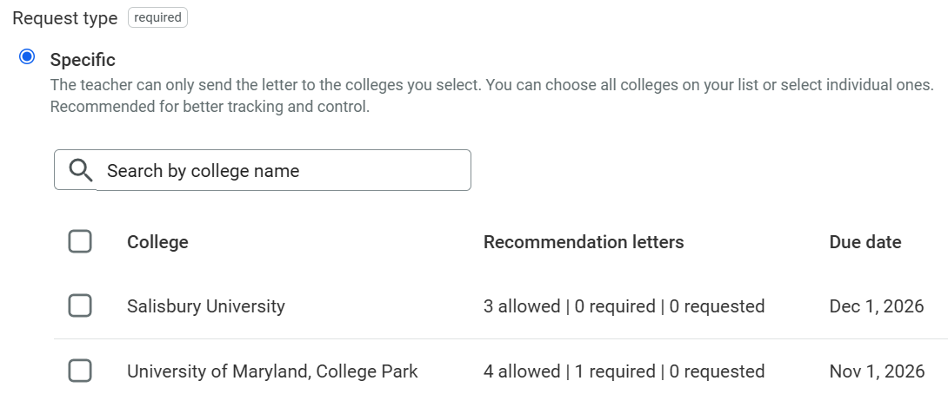
Teacher Letters of Recommendation
  Select Teacher continued
  Once you select a teacher, please select which colleges you want their letter sent to or click this box for the letter to go to all colleges

Slide 15
Letter of Recommendation Requests
Students will need to provide an academic resume
  This includes academic accomplishments, activities (in and out of school), work experience, awards won, interests
https://www.indeed.com/career-advice/resumes-cover-letters/high-school-academic-resume

Slide 16
Use Naviance for the following….
Scholarship information
Class of 2027 updates
Financial Aid information
College Visits/Fairs
ASVAB
Interest Inventories
Résumé Builder

Slide 17
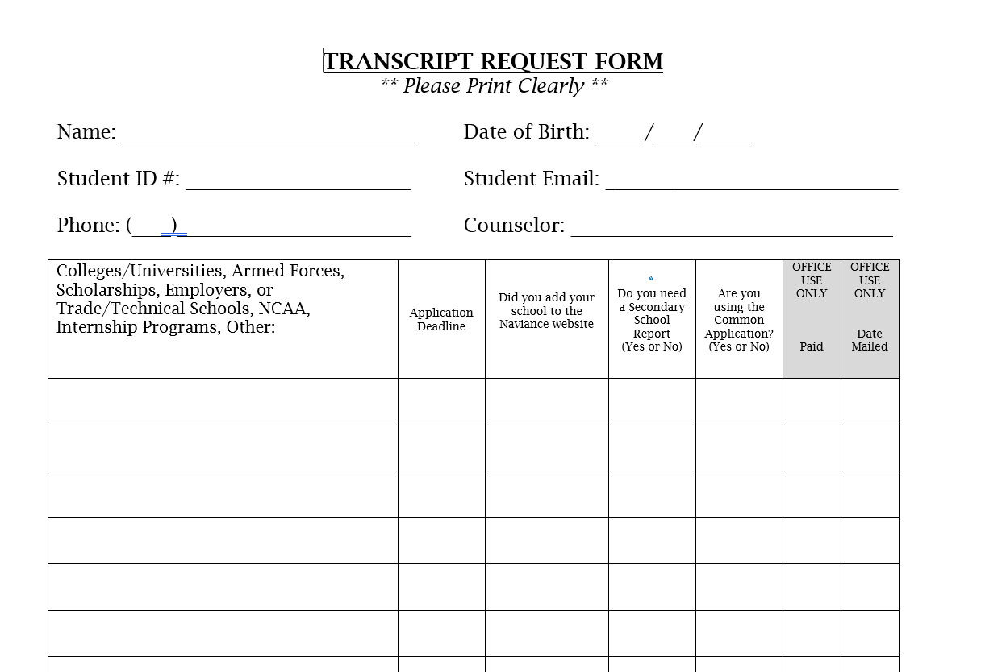

Slide 18
Waiver of Rights
This form needs to be completed before any information can be sent to a post-secondary institution
Please pick up this form from the Counseling Office to complete

Slide 19
Early Action vs. Early Decision
Early Action(EA)
Apply early.
Receive an admission decision early in the admission cycle (usually in January or February).
Consider acceptance offer; do not have to commit upon receipt.
Apply to other colleges under regular admission plans.
Give the college a decision no later than the May 1 national response date.
Early Decision(ED)
Apply early (usually in November) to first-choice college.
Receive an admission decision from the college well in advance of the usual notification date (usually by December).
Agree to attend the college if accepted and offered a financial aid package that is considered adequate by the family.
Apply to only one college early decision.
Apply to other colleges under regular admission plans.
Withdraw all other applications if accepted by ED.
Send a nonrefundable deposit well in advance of May 1.
**ALWAYS READ THE FINE PRINT TO DETERMINE IF EA OR ED IS BINDING; IT VARIES WITH EACH COLLEGE**

Slide 20
Important Reminders
Update your Naviance account as well as your counselor throughout the year regarding admission status and scholarships received
Check your email for important upcoming deadlines

Slide 21
Sending SAT Scores
You receive four score reports every time you register for the SAT. These four score reports must be used at the time of registration or up to nine days after the test date.
You can send score reports at any time from your “My SAT” account through College Board. However, please know there is a fee for sending score reports (per report) starting ten days after the test date.

Slide 22
Video Resource
Please reference the video below to help you connect Naviance and the Common Application
Connecting Common App and Naviance

Slide 23
Senior Contract
Senior Contract Obligation
  Details what your senior needs to graduate in June 2027
  Must be electronically signed by both parent/guardian and the student within PowerSchool
  On August 26th, an email will be sent home with links to instructions on how to complete the form
  Deadline Friday, September 11th

