Slide 1


WELCOME TO CHESAPEAKE
HIGH SCHOOL
HOME OF THE COUGARS
Class of
2030

Slide 2

Student Services
A – B: Ms. Cheryl Shiflett, cshiflett@AACPS.org
C – G: Ms. Amy Maziarz, amaziarz@AACPS.org
H – McG: Mrs. Cate Schenk, cschenk@AACPS.org
McH – Se: Mrs. Kacie Thress, kthress@aacps.org
Sh – Z: Mrs. Kristin Gibbons, kmgibbons@aacps.org
CRP Counselor: Megan Branch, mnbranch@aacps.org
School Psychologist: Ms. Erin O’Keeffe, eokeeffe@AACPS.org
Social Worker: Mrs. Cheryl Florio, cflorio@aacps.org
Registrar: Ms. Cathy Buckwalter, cbuckwalter@AACPS.org
Secretary: Mrs. Lisa Wilson, lrwilson@aacps.org

Slide 3
Administration
Mrs. Shanna Cahoon, Principal
Ms. Jacqueline Jones, Assistant Principal, (A-Eld)
Ms. Jillian Siok, Assistant Principal, (Ell-La)
Mr. Matthew Sneck, Assistant Principal, (Le-Ro)
Ms. Chessil Johnson, Assistant Principal, (Ru-Z)
Mr. Cameren Stevenson, CRP

Slide 4
Why Are Credits Important: Grade Promotion
TO BE PROMOTED TO GRADE 10
  6 CREDITS ARE NEEDED
  3 of these credits needs to be from English, Social Studies, Science, and/or Math
TO BE PROMOTED TO GRADE 11
  13 CREDITS ARE NEEDED
  7 of these credits needs to be from English, Social Studies, Science, and/or Math
TO BE PROMOTED TO GRADE 12
  18 CREDITS ARE NEEDED
  10 of these credits needs to be from English, Social Studies, Science, and/or Math
  YOU MUST ATTEND SCHOOL AND COMPLETE YOUR WORK IN ORDER TO EARN CREDIT

Slide 5
Graduation Requirements
Why Are Credits Important: Graduation
All students need 23 credits in various areas in order to graduate
All students need a completer pathway
All students must take and pass the state exams
All students must complete 75 Service-Learning Hours

Slide 6
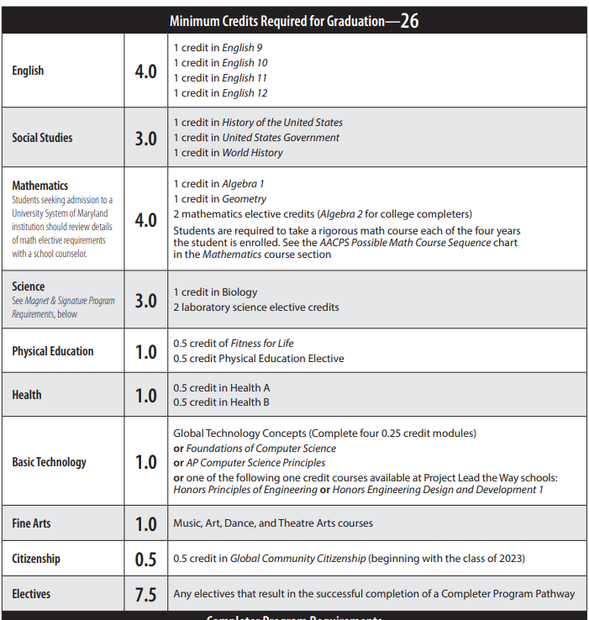
X
23
4.5
X
*Financial Literacy is now a graduation requirement as well

Slide 7
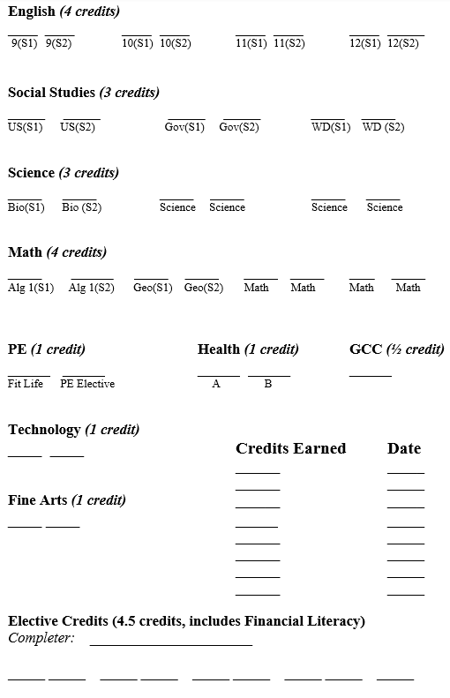

Slide 8
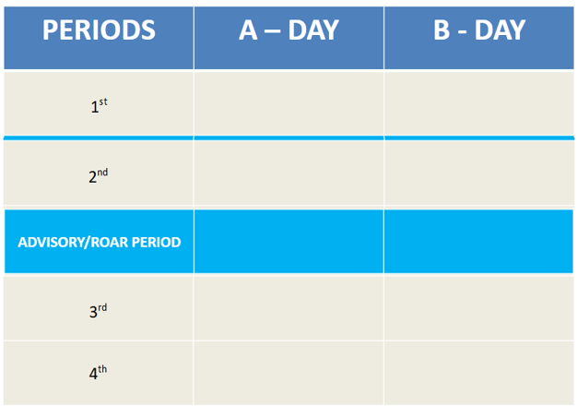
HIGH SCHOOL SCHEDULE

Slide 9
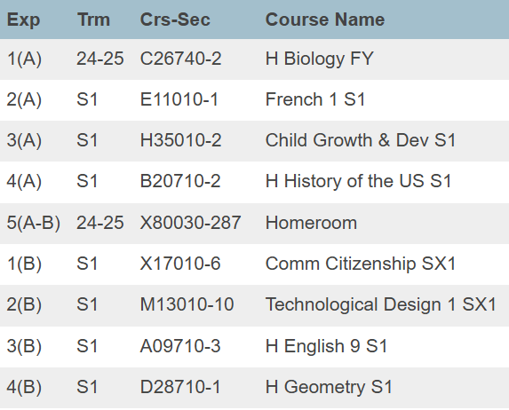
A Sample 9th Grade Schedule

Slide 10
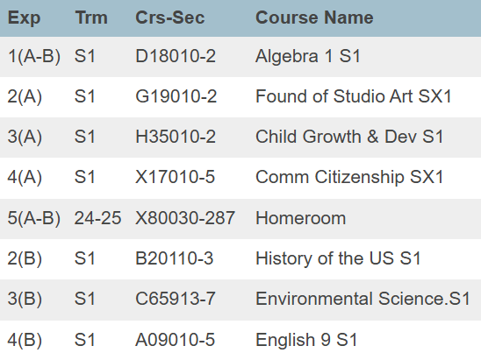
A Sample 9th Grade Schedule

Slide 11
CAT-North Career
Explorations Program
The CAT-N application can be found online; the deadline to apply is March 15th, 2026.
If you experience any issues, please contact:
  Becky Terry at 410-222-5294 rterry@aacps.org
  Kathy Kerry at 410-222-5245
  kakelly@aacps.org

Slide 12
Course Selection Google Form
Click Here

