Slide 1


WELCOME TO CHESAPEAKE
HIGH SCHOOL
HOME OF THE COUGARS
Class of
2030

Slide 2

Student Services
A – B: Mrs. Regina McDowell
C – G: Ms. Amy Maziarz
H – McG: Mrs. Cate Schenk
McH – Se: Mrs. Kacie Thress
Sh – Z: Mrs. Kristin Gibbons
School Psychologist: Ms. Erin O’Keeffe
Social Worker: Mrs. Cheryl Florio
Registrar: Ms. Cathy Buckwalter
Secretary: Ms. Stacy Crutch

Slide 3
Administration
Ms. Shanna Cahoon, Principal
Ms. Jacqueline Jones, Assistant Principal, (A-Eld)
Ms. Jillian Siok, Assistant Principal, (Ell-La)
Mr. Matt Sneck, Assistant Principal, (Le-Ro)
Ms. Chessil Johnson, Assistant Principal, (Ru-Z)

Slide 4
Chesapeake Regional Program (CRP)
Student Services
  Mrs. Megan Branch, School Counselor
  Ms. Brianna Scheuneman, School Psychologist
  Ms. Megan Giles, Social Worker
  Ms. Cynthia Morris, Social Worker
Administration
  Mr. Cameren Stevenson, Assistant Principal
  Mrs. Gola Wanken, Secretary

Slide 5




Get Involved!!
The more you are involved at school, the more fun you will have, and the more people you will meet.
We have a variety of sports and clubs.
Mr. Edward (Chip) Snyder is our Athletic Director and Mr. Sheldon White is our Assistant Athletic Director.
https://chesapeakeathletics.org/

Slide 6

Homeroom Period
Monday morning, after 2nd Period
ROAR Period
Tuesday-Friday after 2nd Period
Students will have time to:
  Attend clubs/organization meetings
  Meet with teachers about grades, assignments, redo tests/quizzes, etc.

Slide 7
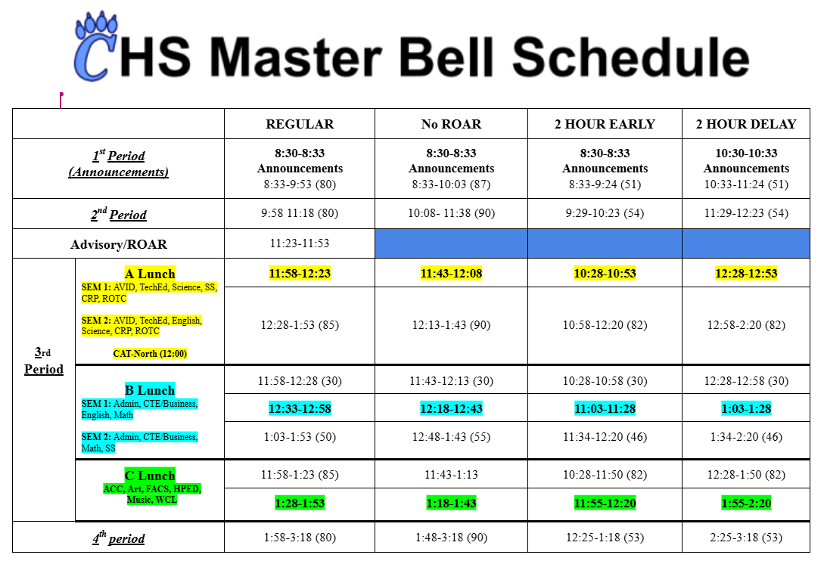

Slide 8
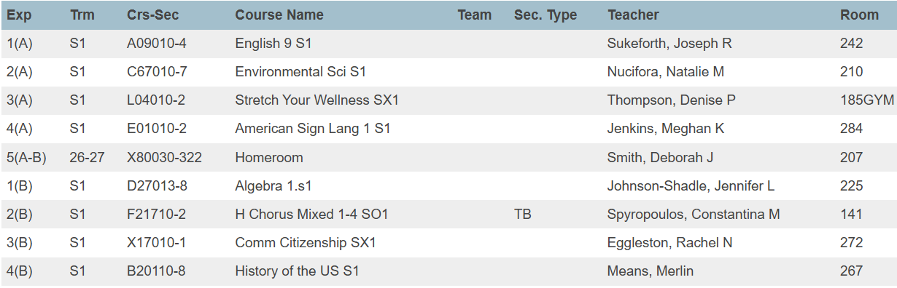
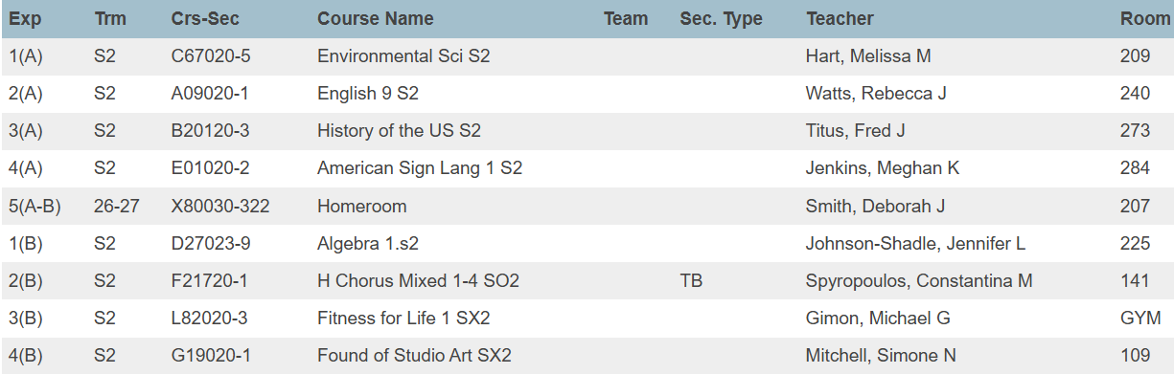
A Sample 9th Grade Schedule
1st Semester
2nd Semester

Slide 9
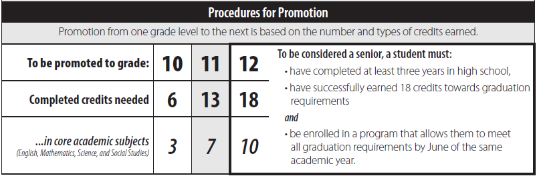
Why Are Credits Important: Grade Promotion
  YOU MUST ATTEND SCHOOL AND COMPLETE YOUR WORK IN ORDER TO EARN CREDIT

Slide 10

Graduation Requirements
Why Are Credits Important: Graduation
All students need 23 credits in various areas to graduate
All students need a completer path
All students must take and pass the state exams
All students must complete Service-Learning Hours

Slide 11

CAT-North Career
Explorations Program
If you have CAT-North during 1B, you will arrive to CHS and get right on the CAT-North bus parked along the sidewalk.
The bus will bring you back to CHS.
CAT-North has the same rules as Chesapeake.
CAT-North starts on Wednesday, August 26th.

Slide 12

HELPFUL TIPS
Stay organized
Do your homework when it is given
Talk to your teacher/parent/counselor when you BEGIN to struggle in a class….Don’t wait
Everything you do COUNTS
Spend time on your academics
Join a club, sport or some other extra curricular activity

Slide 13

HELPFUL TIPS CONTINUED
PARENTS:
Be sure to gather all teachers’ email addresses
Register on Parent Portal (My PowerHub)
Organize your calendar with the county’s calendar
Encourage your child to get involved in a sport or club (more information coming)

Slide 14

9th Grade Day
Monday August 24th
Meet your Homeroom/Advisory Teacher
Tour building
Meet A Day teachers
Meet B Day teachers

Slide 15

Before or after you tour the building…
Visit the school store before you go to load up on your Chesapeake apparel.
Stop by the PTSA table located in the lobby outside of the cafeteria and help support our PTSA.
Stop by to see Ms. Stelmach, our AVID Coordinator, if you’re interested in learning more about the program.
Our Career Coach Ms. Albaugh is in the lobby outside the cafeteria too.

Slide 16

We are looking forward to
working with you
and seeing you at
Back-to-School Night on September 3rd @ 6:00pm

