Slide 1
Ways to Pay for College
Financial Aid Basics and the 2027–28 FAFSA®
Notes:
Welcome students and families. This session covers the basics of paying for college: what financial aid is, where it comes from, and a step-by-step walk-through of the 2027–28 FAFSA form, followed by Maryland state aid, institutional aid, scholarships, and student loans.
Let the audience know that the 2027–28 FAFSA opened September 23, 2026 — the earliest launch in the program's history — so seniors can file now.

Slide 2
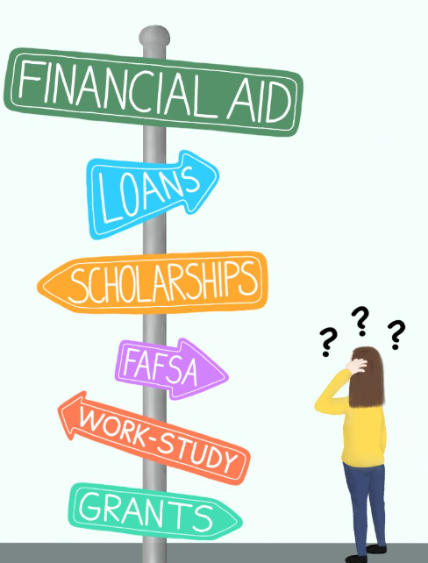
What Is Financial Aid?
Financial aid is money provided to students and families to help pay for education after high school.
It can help pay for:
Tuition and fees
Books, supplies, and a computer
Transportation, housing, and food
Most aid starts with the free FAFSA® form.
Notes:
Financial aid is any money that helps a student and family pay for college costs. It comes from four main places: the federal government, the state, the college itself, and outside organizations.
Emphasize that aid can cover more than tuition — the cost of attendance includes fees, books, supplies, transportation, housing, and personal expenses.
Key takeaway: almost every source of aid starts with one free form — the FAFSA.

Slide 3



Types of Financial Aid
Gift Aid
Does not need to be paid back
Self-Help Aid
Must be repaid or earned
Grants — usually need-based (Federal Pell Grant, Maryland Guaranteed Access Grant)
Scholarships — merit, talent, program, or need (AACC Foundation scholarships)
Student loans — borrowed money repaid with interest
Work-study — earned through a part-time job
Service-commitment awards — require work after graduation
Notes:
There are two broad types of aid.
Gift aid is the best kind: grants and scholarships that do not have to be repaid. Grants are usually based on financial need (for example, the Federal Pell Grant or Maryland's Guaranteed Access Grant). Scholarships may be based on merit, talent, field of study, or need.
Self-help aid is aid you either repay or earn. Student loans must be repaid with interest. Federal Work-Study lets students earn money through a part-time job. Some awards — such as service-commitment scholarships — must be "paid back" through work after graduation, or they convert to loans.
Encourage families to use all available gift aid before borrowing.

Slide 4




Sources of Financial Aid
Federal
U.S. Department of Education
State
Maryland Higher Education Commission
How to apply: Complete the FAFSA® at StudentAid.gov
How to apply: File the FAFSA (or MSFAA) by March 1; create an MDCAPS account
Maryland Student Information System (MDSIS) starting Fall 2027
Institutional
The college you attend
Outside / Third Party
Community, employers, foundations
How to apply: File the FAFSA plus any college applications; meet each college's deadlines
How to apply: Apply directly to each organization; FAFSA may or may not be needed
Notes:
There are four sources of aid, and each has its own application process.
Federal: Complete the FAFSA at StudentAid.gov. This is the only way to be considered for federal grants, work-study, and loans.
State: Maryland uses the FAFSA (or the Maryland State Financial Aid Application for eligible students who can't file a FAFSA). File by March 1 for most Maryland grants, then create an MDCAPS account to track awards.
Institutional: Colleges use the FAFSA plus their own applications and deadlines. Some private colleges also require the CSS Profile.
Outside/third party: Community groups, employers, foundations, and companies. Each sets its own application; some ask for FAFSA results.

Slide 5
What Is the FAFSA®?
FREE
SAI
20
Every year
Never pay to file. Use StudentAid.gov only.
Student Aid Index — used by colleges to measure financial need
Colleges can receive your FAFSA information
Reapply each year you are in college
Free Application for Federal Student Aid — apply at StudentAid.gov/fafsa
Collects student and family information to calculate the Student Aid Index (SAI)
Colleges use the SAI to determine financial need and offer financial aid
Available in English and Spanish
The FAFSA opens October 1st every year— complete it for classes starting summer or Fall 2027
Notes:
The Free Application for Federal Student Aid — the FAFSA — is the form used to apply for federal grants, work-study, and loans. Maryland and most colleges also use it to award their own aid.
The form collects information about the student and family. The U.S. Department of Education uses that information to calculate the Student Aid Index (SAI). Colleges use the SAI to determine financial need and build a financial aid offer.
Key points: the FAFSA is always free (never pay a website to file it); it is available in English and Spanish; it must be completed every year the student is in school; and it can be sent to up to 20 colleges.
The 2027–28 FAFSA opened September 23, 2026. Seniors who will start college in summer or fall 2027 should complete the 2027–28 form. AACC's Federal School Code is 002058.

Slide 6





FAFSA® Eligibility Requirements
U.S. citizen or eligible noncitizen (such as a permanent resident)
Good to know: Selective Service registration and drug convictions no longer affect FAFSA eligibility.
Valid Social Security number (with limited exceptions)
High school diploma, GED or state-recognized equivalent, or state-approved homeschool
Enrolled in an eligible degree or certificate program
Not eligible for federal aid? Maryland Dream Act students may qualify for state aid with the MSFAA. Details: StudentAid.gov/eligibility
Maintain Satisfactory Academic Progress (SAP) in college
Not in default on a federal loan or owe a federal grant refund
Notes:
To receive federal student aid, a student generally must:
Be a U.S. citizen or eligible noncitizen (for example, a permanent resident). Details are at StudentAid.gov/eligibility.
Have a valid Social Security number (with limited exceptions).
Have a high school diploma, GED or other state-recognized equivalent, or have completed a homeschool program approved under state law.
Be enrolled or accepted for enrollment in an eligible degree or certificate program.
Maintain Satisfactory Academic Progress once in college.
Not be in default on a federal student loan or owe a grant overpayment.
Note for families: under FAFSA Simplification, Selective Service registration and drug convictions no longer affect eligibility. Parents who do not have a Social Security number can still create a StudentAid.gov account and contribute to the form.
Students who are not eligible for federal aid — for example, Maryland Dream Act students — may still qualify for Maryland state aid using the Maryland State Financial Aid Application (MSFAA).

Slide 7
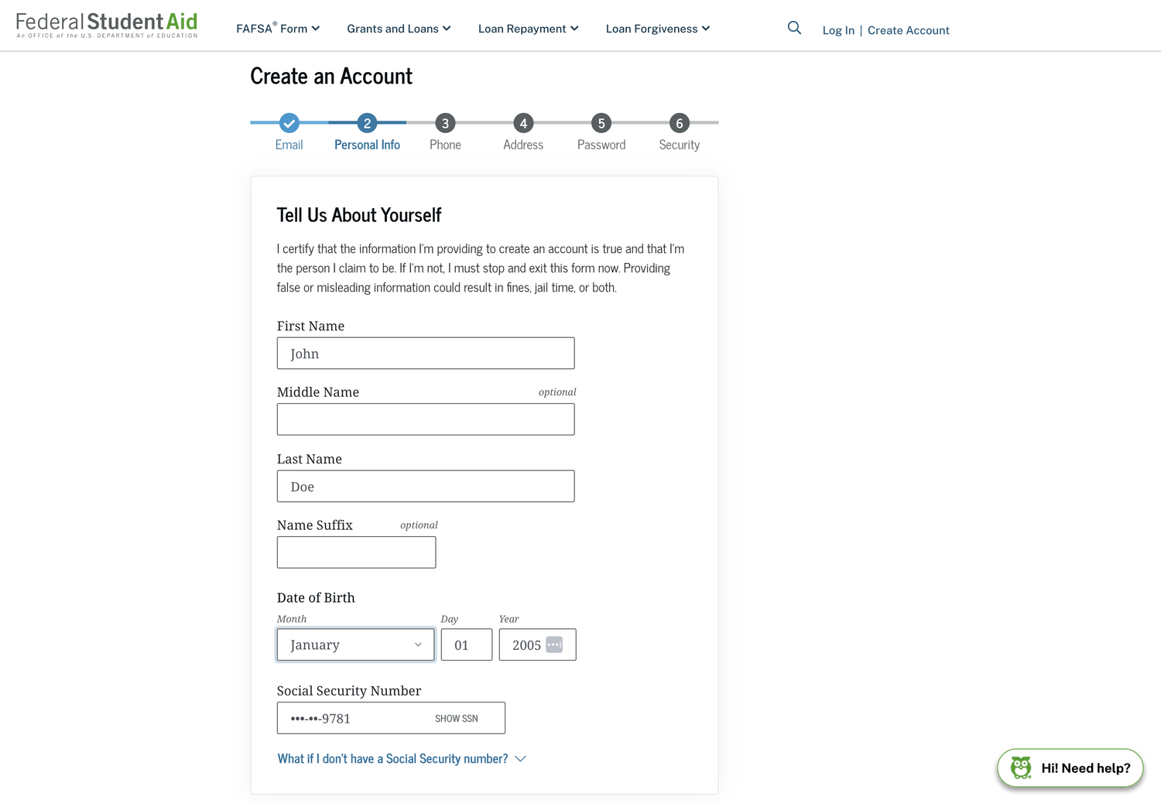
Create Your StudentAid.gov Account (FSA ID)
Go to StudentAid.gov and select Create Account
Choose English or Español
Enter and verify your email with a 6-digit code
Enter your legal name, date of birth, and Social Security number
Add and verify a mobile phone number
Enter your mailing address
Create a username and password, review two-step verification, and save your backup code
Tip: Student and each parent need their own account. Use a personal email, not a school email.
Notes:
The StudentAid.gov account username and password is often still called the FSA ID. It is required to start, sign, and submit the FAFSA.
Each person needs their own account: the student, and each contributor (parent or spouse). Accounts can't be shared, and an email address can be linked to only one account. A phone number can be used with up to five accounts.
Steps: select language, verify email with a secure code, enter personal information, verify mobile phone, enter mailing address, create username and password, and confirm two-step verification methods. Save the backup code in a safe place.
Tip: create accounts a few days before filing. The Social Security Administration must match the information, which can take one to three days. Use a personal email, not a high school email that may expire.

Slide 8
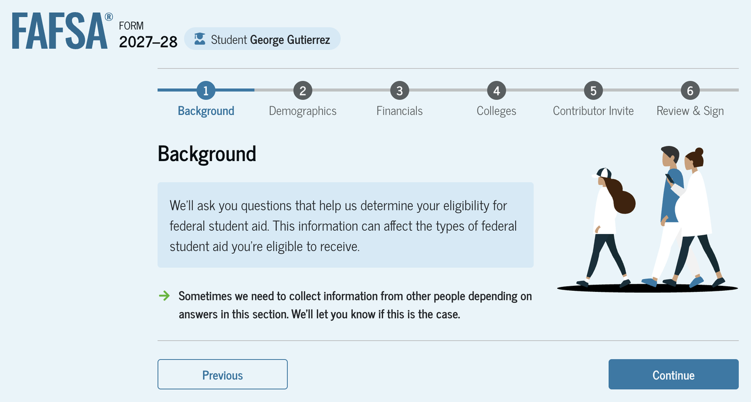
FAFSA® Sections
Intro
Personal Identifiers — Identity, state of residence, consent
1
Background — Marital status, grade level, dependency questions
2
Demographics — Citizenship, parent education, high school
3
Financials — Tax filing, tax return information, assets
4
Colleges — Send your FAFSA to up to 20 schools
5
Contributor Invite — Dependent students invite a parent
6
Review & Sign — Review, accept terms, and sign
Notes:
The 2027–28 student section is organized into an introduction plus six numbered steps that appear in the progress bar at the top of each page.
Personal Identifiers (introduction): confirm identity, state of residence, and provide consent and approval.
1. Background: marital status, college grade level, and dependency questions.
2. Demographics: sex, race/ethnicity (research only), citizenship, parent education, and high school completion.
3. Financials: tax filing status, tax return information, and assets.
4. Colleges: select up to 20 schools.
5. Contributor Invite: dependent students invite a parent.
6. Review & Sign: review answers, accept terms, and sign.
Independent students who don't need a contributor will see "Signature" as their last step. Contributors see a shorter section: Demographics, Financials, and Review & Sign.

Slide 9
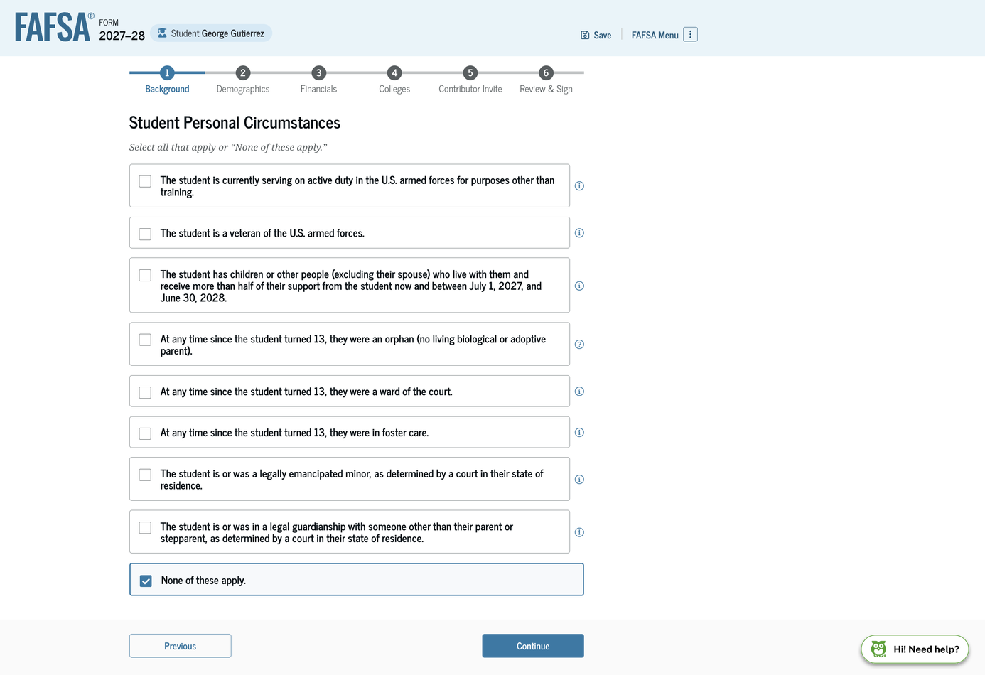
Background: Dependency Questions
Determines whether the student is dependent (must include parent information) or independent
Asks about military service, supporting children or dependents, orphan/foster care/ward of the court, emancipated minor, or legal guardianship
Also asks marital status, college grade level, and whether you'll have a bachelor's degree
If “None of these apply,” the student is dependent and must invite a parent contributor
Notes:
The Background section — called "Personal Circumstances" last year — asks the questions that determine dependency status.
A student is independent for 2027–28 if they were born before January 1, 2004; are married; will be a graduate student; are a veteran or serving on active duty; have children or other dependents they support; were an orphan, ward of the court, or in foster care at any time after turning 13; are or were an emancipated minor or in legal guardianship; or are an unaccompanied youth who is homeless or at risk of homelessness.
Most graduating high school seniors will answer "None of these apply," which means they are dependent. Dependency status is not about whether the student lives with parents or whether parents claim them on taxes — it is defined by federal law. Dependent students must invite a parent as a contributor.

Slide 10
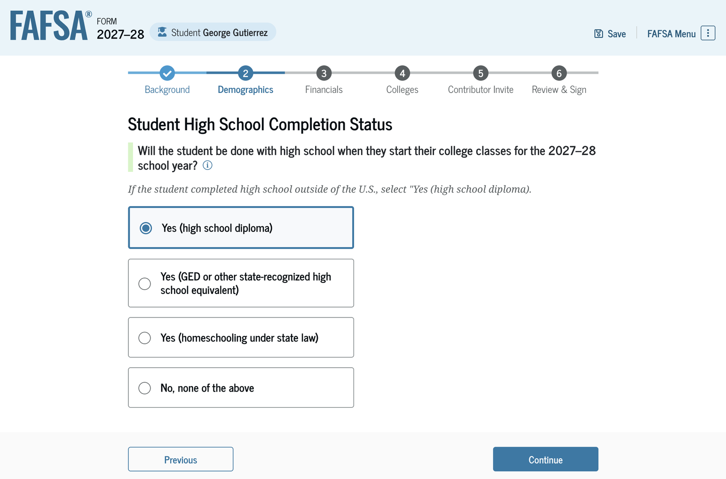
High School Completion Status
Asks what your status will be when you start college in 2027–28 — not your status today
Seniors graduating in spring 2027 should select “Yes (high school diploma)”
Common error: Choosing “No, none of the above” makes you ineligible. You would have to log back in and correct it.
Notes:
This is one of the most common FAFSA errors we see.
The question asks whether the student will be done with high school when they start their college classes in the 2027–28 school year. Seniors who will graduate in spring 2027 should select "Yes (high school diploma)" even though they haven't graduated yet.
If a student selects "No, none of the above," they won't be eligible for federal aid. They will have to log back in and submit a correction, which delays their aid.
After this question, the student searches for and confirms their high school.

Slide 11
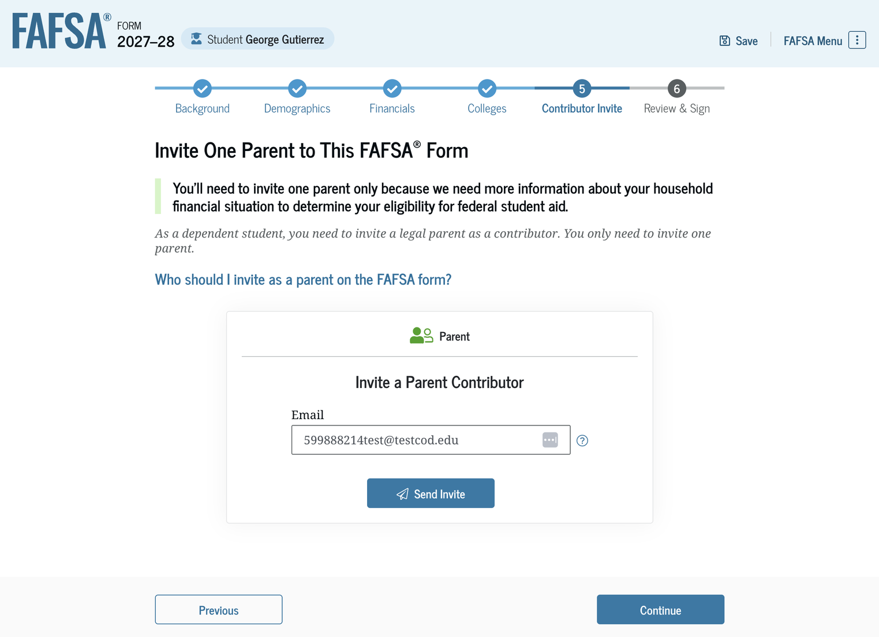
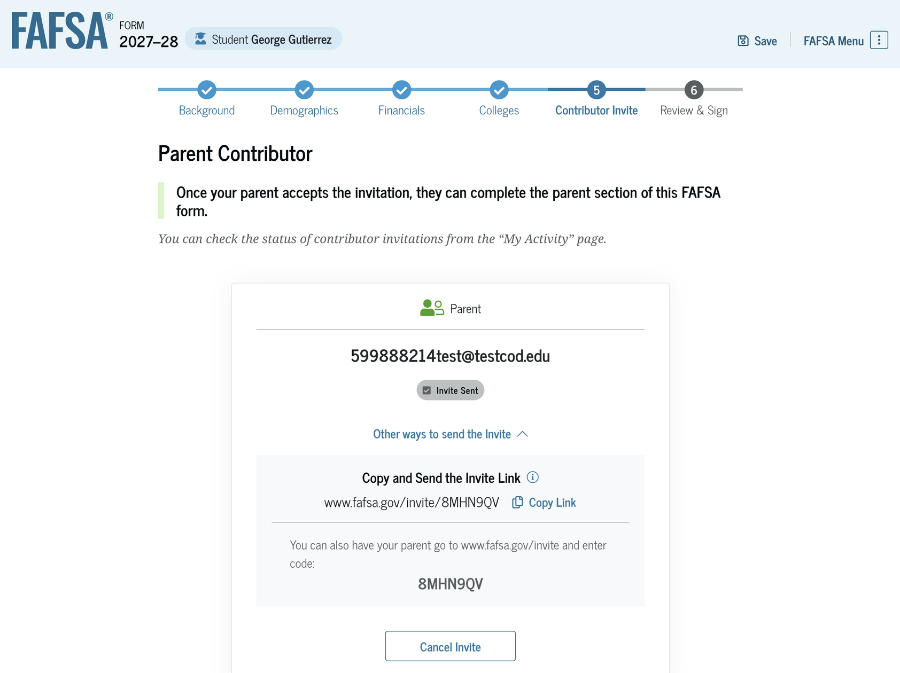
Student Invites Contributor
Enter the parent's email address — use the email linked to the parent's StudentAid.gov account
Select Send Invite and confirm
Or share the invite link or invite code by text or email
Notes:
Dependent students must invite one legal parent as a contributor. The intro page explains who counts as a legal parent and links to the "Who's My FAFSA Parent?" wizard.
The student enters the parent's email address and selects "Send Invite," then confirms the email in a pop-up. Use the email address linked to the parent's StudentAid.gov account.
The confirmation page shows an invite link and an invite code. The student can share these directly with the parent by text or email. This is especially helpful if the email invitation goes to spam.

Slide 12
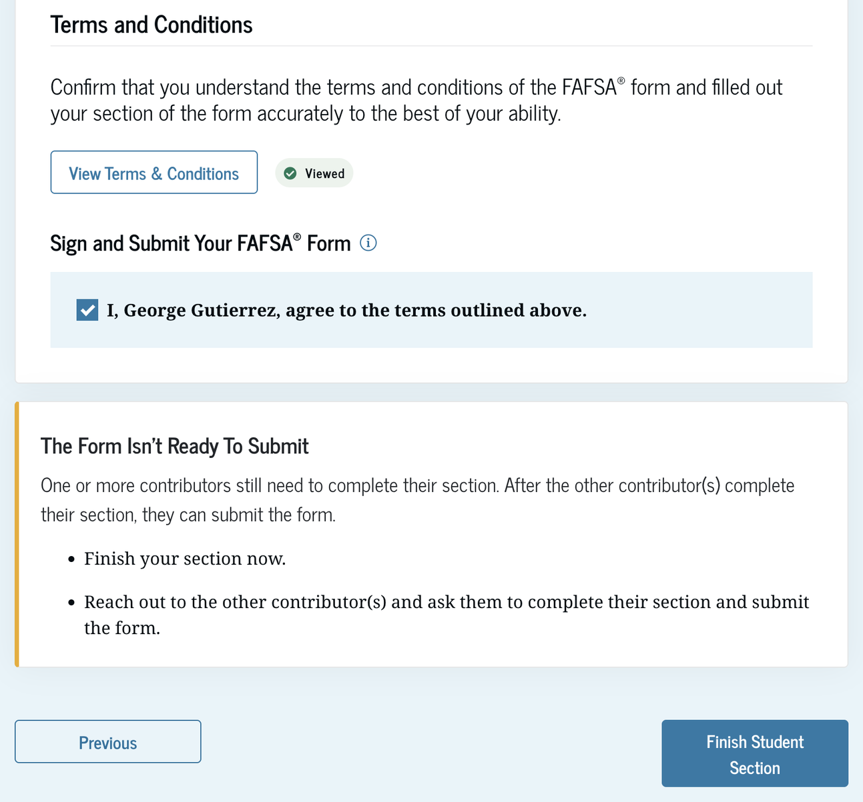
Student Signature
Select View Terms & Conditions and read them
Check the box to agree — this is your electronic signature
Select Finish Student Section
The FAFSA® is not done until it is signed!
Reminder: An unsigned FAFSA is never processed. Both the student and the contributor must sign.
Notes:
New for 2027–28, "Signature" is now part of the "Review & Sign" section, and signing happens on one page.
At the bottom of the review page, the student must select "View Terms & Conditions," read them, and select "Done." The status changes to "Viewed." Then the student checks the box agreeing to the terms — this is the electronic signature — and selects "Finish Student Section."
For a dependent student, the form isn't complete until the parent also completes and signs their section. A FAFSA that isn't signed is never processed.

Slide 13
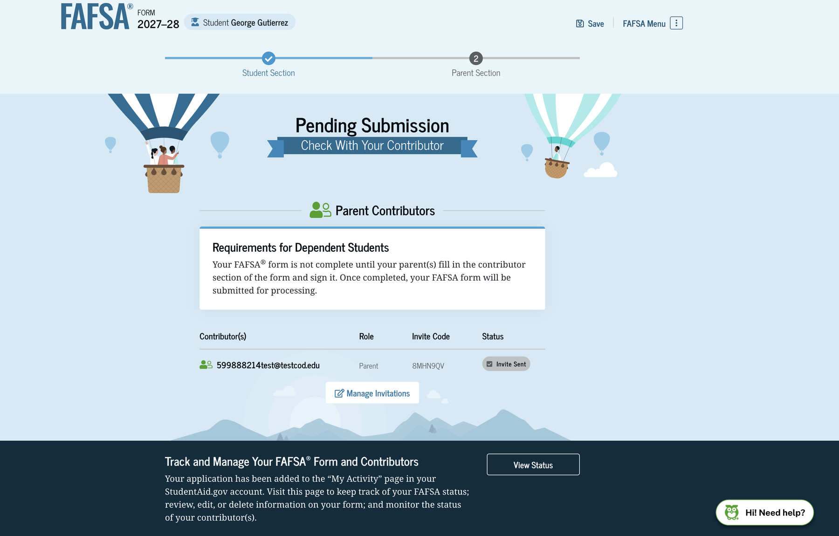
Student Section Complete
Status shows Pending Submission
The FAFSA® can't be processed until the parent completes and signs their section
Track the invite and manage contributors with View Status
The student also receives a confirmation email
Notes:
After signing, the student sees the "Pending Submission" page. It confirms the student section is complete, but the form can't be processed until the parent contributor completes and signs their section.
The page shows the contributor and their invite status. The student can select "View Status" to track the form and manage contributors in the "My Activity" section of their StudentAid.gov account.
The student should follow up with their parent to make sure the parent section gets done.

Slide 14
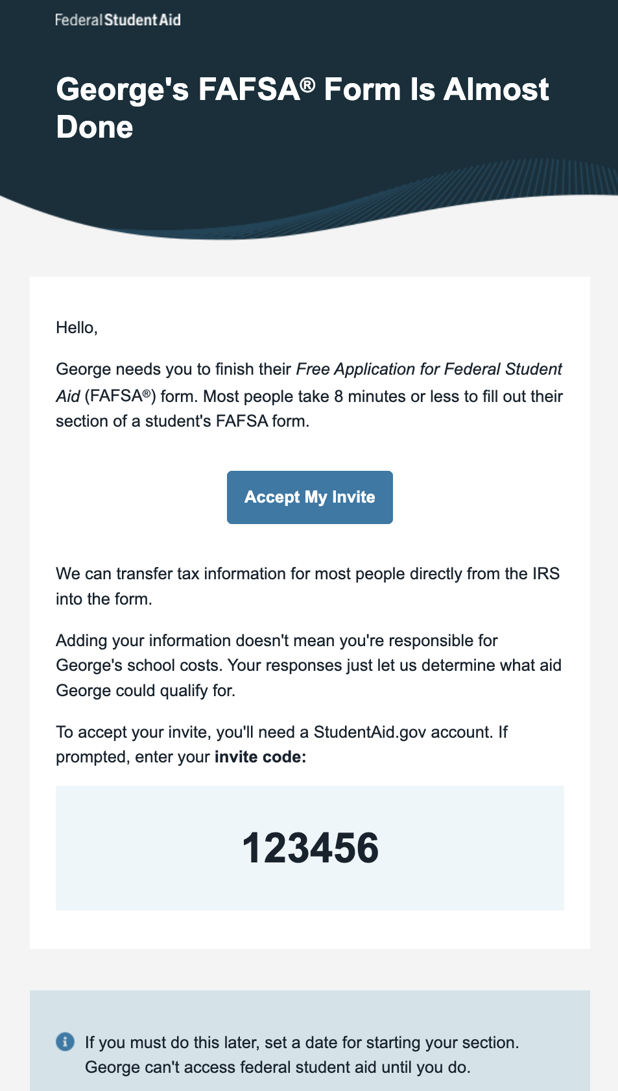
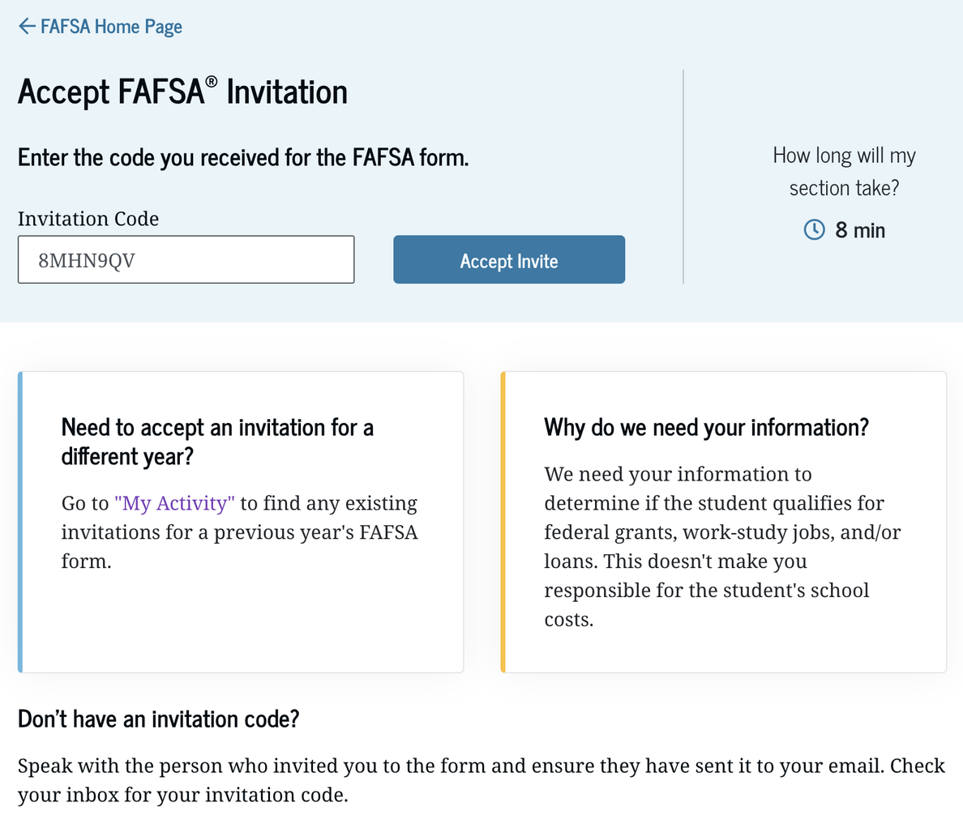
Contributor Accepts Invitation
Open the email from Federal Student Aid and select Accept My Invite
Select Login to Accept Invite and log in with the parent's own StudentAid.gov account
The invite code is filled in for you — select Accept Invite
Or go to StudentAid.gov/fafsa → Accept an Invitation and enter the code
Notes:
The parent receives an email from Federal Student Aid with the student's name, an "Accept My Invite" button, and the invite code.
The easiest path: select "Accept My Invite" in the email. The "Accept FAFSA Invitation" page opens. The parent selects "Login to Accept Invite" and logs in with their own StudentAid.gov account — never the student's. Because they came from the email link, the code is already filled in. They select "Accept Invite," then "Accept" in the pop-up.
Another path: go to the FAFSA landing page at StudentAid.gov, select "Accept an Invitation," and type in the code.
Federal Student Aid says most contributors take about 8 minutes to finish their section.

Slide 15
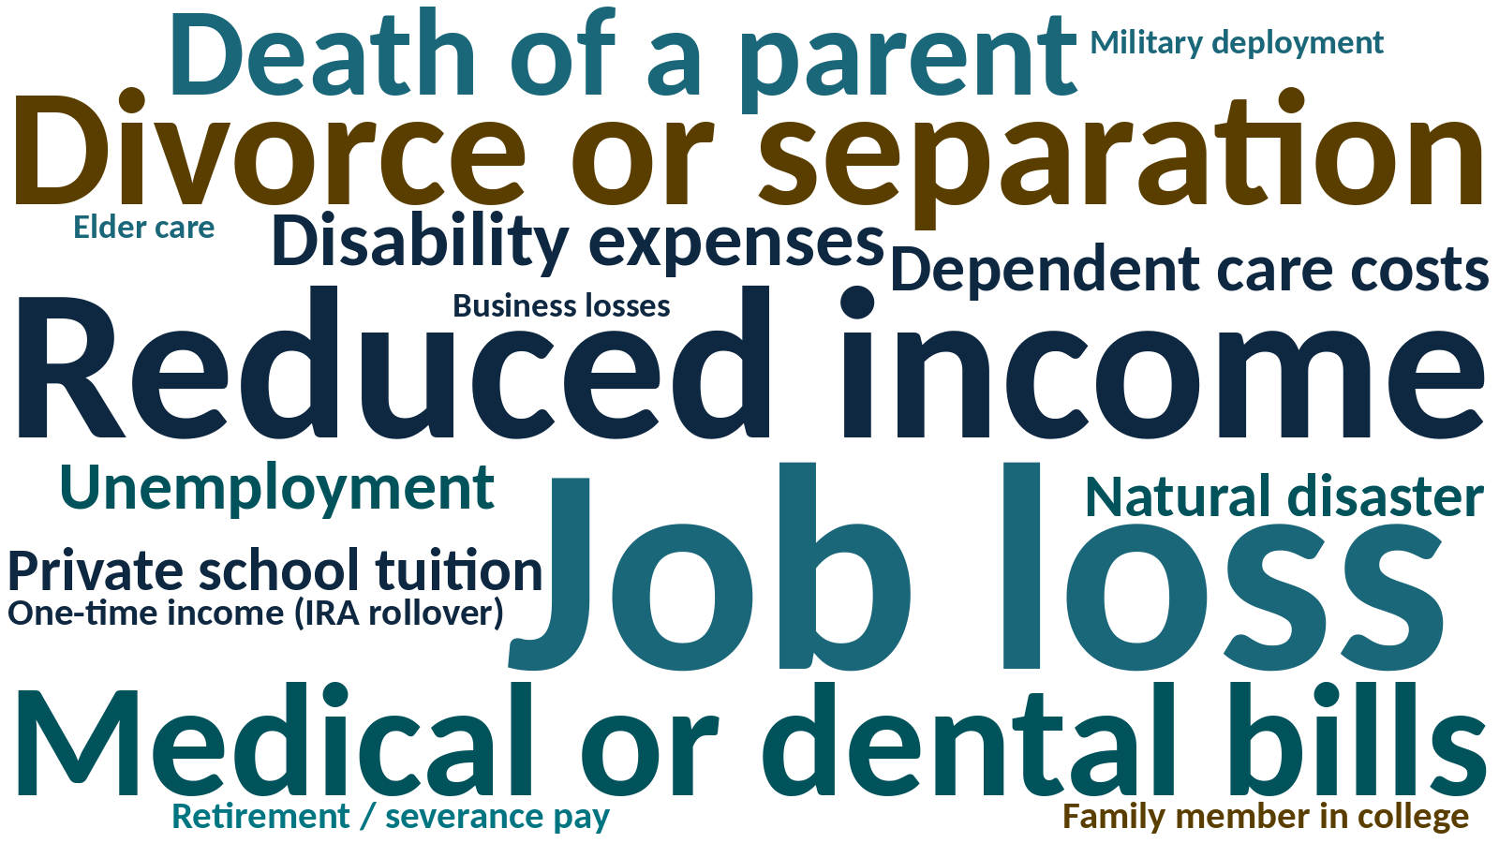
Special Circumstances
A change or situation the FAFSA doesn't show, because it uses 2025 income
Does not change dependency status (unlike unusual circumstances)
What to do:
Submit the FAFSA first
Contact each college's financial aid office
Provide documentation if asked
Each college decides; decisions can't be appealed to the U.S. Department of Education
Notes:
A special circumstance is a change or situation that the FAFSA doesn't capture, because the FAFSA looks at 2025 income — two years before the school year starts.
Examples include job loss or reduced income, divorce or separation, death of a parent or spouse, high medical or dental bills not covered by insurance, dependent care or elder care costs, private elementary or secondary school tuition, natural disasters, and one-time income such as an IRA rollover or severance pay.
Special circumstances are different from unusual circumstances: they do not change a student's dependency status.
How to handle it: complete and submit the FAFSA as accurately as possible, then contact each college's financial aid office. The office may ask for documentation and can use professional judgment to adjust the information used to calculate aid. Each college decides independently, and decisions are final — they can't be appealed to the Department of Education. The FAFSA links to an article titled "What if you have special financial circumstances?" in the Financials section introduction.

Slide 16



Maryland State Financial Aid
Administered by the Maryland Higher Education Commission (MHEC) Office of Student Financial Assistance
File the FAFSA by March 1 every year
Most state grants use March 1. Some programs have other deadlines.
Create an MDCAPS account
MHEC invites you after your FAFSA is received
Can't file a FAFSA?
Use the Maryland State Financial Aid Application (MHEC One App), such as for Maryland Dream Act students
mhec.maryland.gov
Notes:
Maryland's state financial aid programs are administered by the Maryland Higher Education Commission (MHEC) Office of Student Financial Assistance.
To apply: complete the FAFSA by March 1 each year. Students who can't file a FAFSA — such as Maryland Dream Act students — complete the Maryland State Financial Aid Application (MSFAA) instead.
After the FAFSA is filed, MHEC invites students to create an MDCAPS account, the Maryland College Aid Processing System. Some programs require extra applications or documents in MDCAPS, and many programs have different deadlines, so check the MHEC "Scholarship and Grant Deadlines" page.
Students must reapply every year.

Slide 17
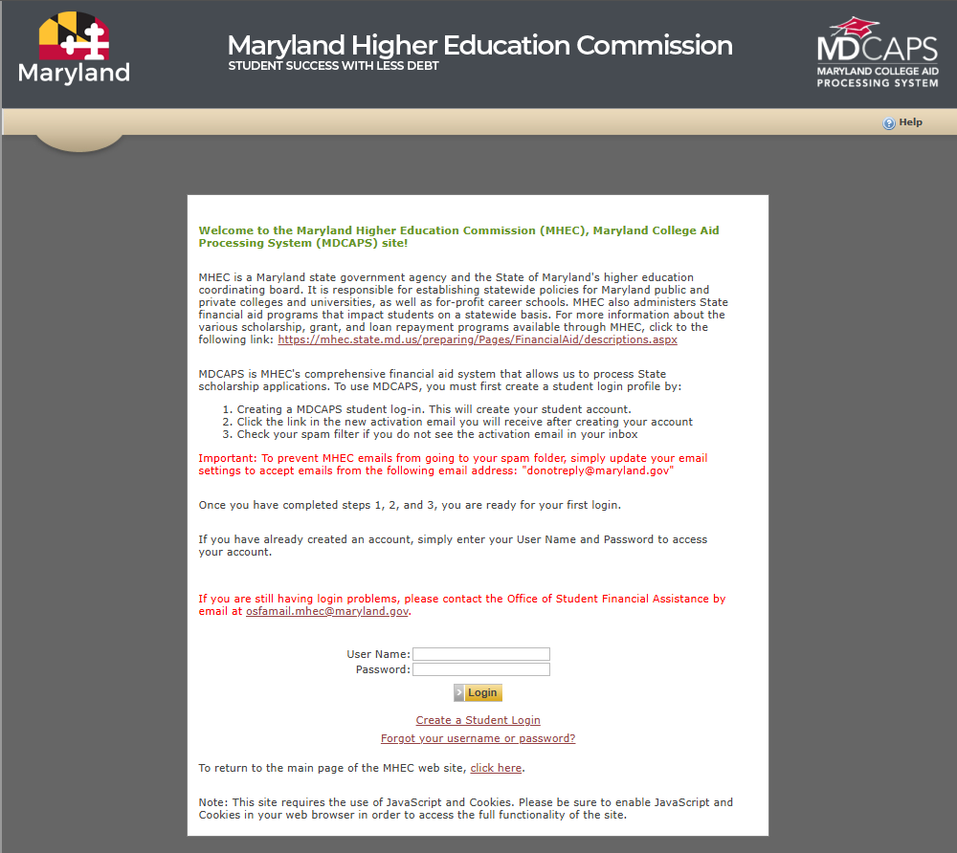
MDCAPS: Log In
Website: mdcaps.mhec.state.md.us
What to know
After you submit the FAFSA®, MHEC emails an invitation to create an MDCAPS account
Select Create a Student Login and activate your account from the email
Use MDCAPS to
Track your state financial aid status
Submit documents and check eligibility
Accept your awards online
Notes:
MDCAPS — the Maryland College Aid Processing System — is MHEC's online portal for state financial aid. The address is mdcaps.mhec.state.md.us.
After the FAFSA is submitted, MHEC sends an email inviting the student to create an MDCAPS account. To create one, select "Create a Student Login," then activate the account with the link in the confirmation email.
Use MDCAPS to track state financial aid status, upload documents, check eligibility, and accept awards. Bookmark the site and check it regularly.
Note for presenters: this is a screenshot of the MDCAPS website, not the FAFSA.

Slide 18



Maryland State Financial Aid Programs
Need-Based Grants and Scholarships
Legislative Scholarships
Career, Transfer, and Specialized
Guaranteed Access Grant
Educational Assistance Grant
Campus-Based Educational Assistance Grant
Part-Time Grant
MD Community College Promise Scholarship
Senatorial Scholarship
Delegate Scholarship
Contact your state senator and delegates
2+2 Transfer Scholarship
Workforce Shortage Student Assistance Grant
Teaching Fellows for Maryland
Conroy and Riley scholarships
Deadlines vary by program — see MHEC Scholarship and Grant Deadlines
Notes:
Maryland offers more than a dozen state programs. Here are the main groups.
Need-based grants and scholarships: Howard P. Rawlings Guaranteed Access Grant, Howard P. Rawlings Educational Assistance Grant, Campus-Based Educational Assistance Grant, Part-Time Grant, and the Maryland Community College Promise Scholarship. Most use the FAFSA or MSFAA filed by March 1.
Legislative scholarships: Senatorial and Delegate scholarships. Students contact their state senator and delegates; some require a separate application.
Career, transfer, and specialized programs: the 2+2 Transfer Scholarship, Workforce Shortage Student Assistance Grant, Teaching Fellows for Maryland, Edward T. and Mary A. Conroy Memorial Scholarship, Charles W. Riley Firefighter scholarship, and others.
Deadlines and requirements vary — always check the MHEC "Scholarship and Grant Deadlines" page.

Slide 19

Anne Arundel Community College Scholarships
The AACC Foundation has over 200 scholarships and awards over $2,000,000 annually
One online application considers you for all AACC Foundation scholarships you qualify for
Priority deadline: March 1
Also complete the FAFSA® (code 002058) and the AACC admissions application
Scholarships are also available for Continuing Education (noncredit) workforce programs
Questions? finaidscholarships@aacc.edu
200+
$2M+
scholarships
awarded each year
www.aacc.edu/scholarships
Notes:
The AACC Foundation offers more than 200 scholarships and awards more than $2,000,000 every year.
Students complete one online application through the AACC Scholarship Portal to be considered for all AACC Foundation scholarships they qualify for. Priority deadline is March 1. Students should also complete the FAFSA (using AACC's school code, 002058) and the AACC admissions application. Recent high school graduates will need to submit their final high school transcript.
Scholarships are also available for many noncredit Continuing Education and Workforce Development programs that lead to a workforce training certificate — for example, Certified Nursing Assistant, Commercial Driver's License, and welding.
Learn more at aacc.edu/scholarships, or email finaidscholarships@aacc.edu.

Slide 20
Institutional Financial Aid
1
Research early
Every college has different policies, forms, and deadlines
SPEAK UP
2
Submit everything
Send all requested applications and documents on time
Did your situation change?
3
Review and ask
Compare offer letters; ask for a review if your situation changed
Contact the financial aid office and ask for a review of your offer.
4
Accept your awards
Accept or decline each award; complete loan requirements
5
Reapply every year
File the FAFSA® annually and keep up your grades (SAP)
ANNE ARUNDEL COMMUNITY COLLEGE
Notes:
Option D: Rows with side callout

Slide 21


Third-Party Scholarships
Start in October: The earlier you apply, the less competition — and watch the deadlines.
High school counselors
Naviance and local scholarships
StudentAid.gov
studentaid.gov/scholarships
CareerOneStop
U.S. Department of Labor's free scholarship finder
Check legitimacy
Use only legitimate search sites
NEVER PAY FOR SCHOLARSHIP SERVICES. Legitimate scholarships are free to apply for. Line up recommendation letters early and write 2–3 strong essays you can adapt.
Notes:
Outside scholarships come from businesses, community groups, foundations, and professional organizations.
Start looking and applying in October — the earlier you apply, the less competition there is. Keep a calendar of deadlines.
Use as many resources as you can: high school counselors and Naviance, the free scholarship search at StudentAid.gov/scholarships, and the U.S. Department of Labor's free CareerOneStop scholarship finder.
Only use legitimate scholarship search sites, and never pay for scholarship services or to apply for a scholarship. Legitimate scholarships don't charge fees.
Tips: line up letters of recommendation early and write two or three strong essays you can adapt — many essay prompts are similar. Reach out to community groups, employers, and organizations you are affiliated with.

Slide 22
Free Scholarship Search Services
Scholarship Finder | CareerOneStop
careeronestop.org
College Board BigFuture Scholarship Search
bigfuture.collegeboard.org
CollegeXpress
collegexpress.com
Fastweb
fastweb.com
FinAid – Scholarships
finaid.org/scholarships
Scholarships.com
scholarships.com
Scholarship America
scholarshipamerica.org
Unigo
unigo.com
All of these services are free but funded by advertising. AACC does not endorse any of these products or services.
Notes:
These are free scholarship search services. All of them are free to use, but they are funded by advertising. AACC does not endorse any of these products or services.
Remind students to protect their personal information. Legitimate search sites don't ask for a credit card or bank account number.

Slide 23

Student Loans: Federal vs. Private
Federal Direct Loans
Private Loans
From the U.S. Department of Education — FAFSA® required
Fixed interest rates and annual limits
No credit check for students
Income-driven repayment, deferment, and forgiveness options
Subsidized: need-based; no interest while in school at least half time
Unsubsidized: not need-based; interest accrues right away
From banks, credit unions, or other lenders — no FAFSA® needed
Variable or fixed rates; may allow higher limits
Credit-based; a cosigner is usually required
Not eligible for federal forgiveness or income-driven repayment
Repaid to the private lender or servicer
Borrow federal first, and borrow only what you need.
Notes:
If you need to borrow, start with federal student loans. They have more protections than private loans.
Federal Direct Loans: offered by the U.S. Department of Education; require the FAFSA; fixed interest rates and annual borrowing limits; no credit check for students; access to income-driven repayment, deferment, and forgiveness programs. Subsidized loans are need-based and the government pays the interest while the student is in school at least half time. Unsubsidized loans are not need-based, and interest starts accruing right away. Repaid to a federal loan servicer.
Private loans: offered by banks, credit unions, and other lenders; no FAFSA required; variable or fixed rates and sometimes higher limits; credit-based, usually requiring a cosigner for students; not eligible for federal forgiveness or income-driven repayment. Some lenders offer incentives for qualified borrowers. Repaid to the private lender or servicer.
Borrow only what you need, and compare total cost before borrowing.

Slide 24


Changes to the Federal Student Loan Program
Schedule of Reduction (SOR)
Starting with loans for 2026–27 (July 1, 2026), annual Direct Loan limits are reduced in proportion to enrollment for students attending less than full time
Full time (12+ credits) = 100% of the annual limit
Example: 9 credits ≈ 75% of the full-time limit (about $4,125 of a $5,500 first-year limit)
Parent PLUS loans are now capped at $20,000 per year per student
What AACC students need to know
Fewer than 12 eligible credits proportionally reduces federal loan eligibility
Adding, dropping, or withdrawing may trigger a loan recalculation
At least 6 eligible credits are required to receive any Direct Loan disbursement
Aid, including loans, pays only for courses required for your program
Notes:
Under the One Big Beautiful Bill Act, starting with the 2026–27 award year (loans disbursed on or after July 1, 2026), annual Direct Loan limits are reduced for students enrolled less than full time. This is often called the "schedule of reduction."
How it works: the annual loan limit is reduced in proportion to the student's enrollment. For example, a student enrolled at three-quarter time would generally be eligible for about 75% of the full-time annual loan limit. A first-year dependent student whose full-time limit is $5,500 would be eligible for roughly $4,125 at 9 credits. This is an illustration only — the actual amount depends on the college's calculation and the student's enrollment over the academic year.
What AACC students need to know:
Enrolling in fewer than 12 eligible credit hours proportionally reduces federal loan eligibility.
Adding, dropping, or withdrawing from classes may trigger a recalculation of the loan amount.
A student must be enrolled in at least 6 eligible credit hours to receive any Direct Loan disbursement.
Financial aid, including loan funds, can only be applied to courses required for the student's program.
Parents: also starting July 1, 2026, new Parent PLUS borrowing is capped at $20,000 per year per dependent student, with a $65,000 lifetime cap per student.
The Department of Education continues to issue guidance — always check with the AACC Financial Aid Office for current details.

Slide 25

Financial Aid Resources
Federal Student Aid Information Center
AACC Financial Aid Office
Live chat and email: StudentAid.gov/help-center/contact
Phone: 1-800-433-3243
Contact us if you're interested in attending AACC or have general financial aid questions.
Email: finaid@aacc.edu
Phone: 410-777-2203
Location: Student Services Center (SSVC), Room 160
Federal Student Aid on social media
YouTube: @FederalStudentAid
Instagram: @FederalStudentAid
X (Twitter): @FAFSA
Notes:
Contact information for questions after tonight.
AACC Financial Aid Office: email finaid@aacc.edu, phone 410-777-2203, located in the Student Services Center, room 160. Contact us if you're interested in attending AACC or have general financial aid questions.
Federal Student Aid Information Center: help is available through StudentAid.gov/help-center/contact, including live chat and email, or by phone at 1-800-433-3243.
Federal Student Aid social media: YouTube @FederalStudentAid, Instagram @FederalStudentAid, and X (formerly Twitter) @FAFSA.

